Slide 1
Unit2
Basics Of C Programming

Slide 2

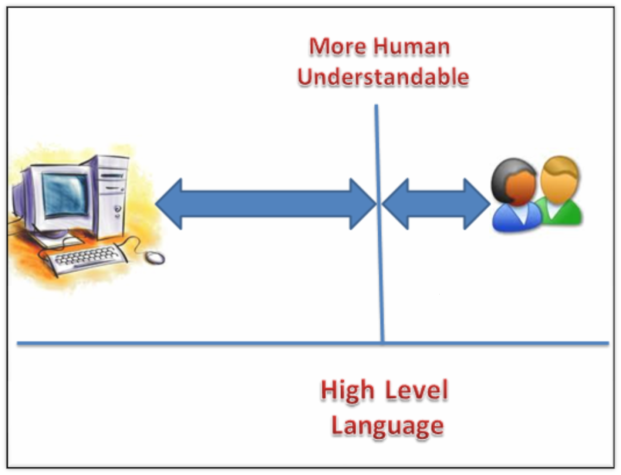
Introduction to ‘C’
‘C’ is a programming language. It is strong, simple and reliable.

Slide 3

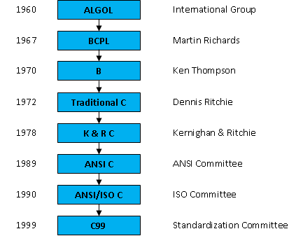

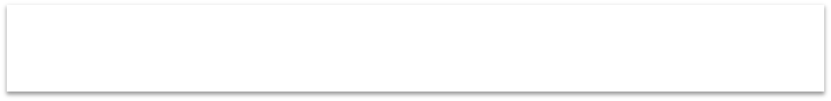

History Of ‘C’
C ‘ programming was written by Dennis Ritchie in 1972. It was developed at AT & T’s Bell Laboratories in USA.

Slide 4
Steps In Learning C: 1. Character set :- Any alphabet(A-Z,a-z),digit(0-9) or special symbol used to represent the data. 2.Keywords,Identifiers,Variables,Constants 3.Instruction statement 4.Program

Slide 5
Token :- When we write a paragraph the individual words and punctuation marks are called as tokens. Or the smallest individual unit in a ‘c’ program is called as C tokens. E.g:- printf(“\n welcome”); Here each and every valid unit of a ‘c’ program is considered as token.

Slide 6

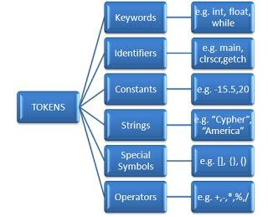
‘C’ Tokens

Slide 7
Keywords:- These are the reserved words . The meaning of these words are already known to the C compiler. There are total 32 keywords in C. Keywords are always written in small case letters. These keywords can not be used as variable.

Slide 8
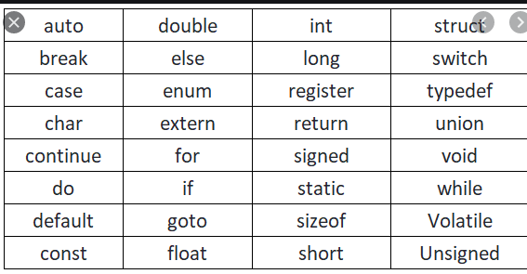
Keywords 32

Slide 9
Identifier:- Identifier is a collection of alphanumeric characters. Identifiers are used to give name to the programming elements like variable, arrays,functions,structures etc. Identifiers are user defined. Identifiers can be written in both lower case and upper case . E.g:- sum,add, area_of_circle, no1,NO1,number,a,b,c,No1

Slide 10
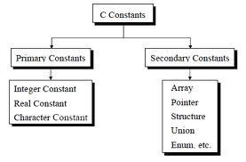
‘C’ Constants
int m = 56; float pi=3.14; char a=‘6’
Here, 56 is Constant and m is Variable. Here 3.14 is constant ,pi is variable
Define constant:- It is an entity which remains same throughout the program is called as constant
Types of Constants :
Primary Constants
Secondary Constants
Type | Example
Integer constants | +226 , -946, 9,78
float constants | +123.23, -22.34,3.14
character constants | ‘G’ , ‘5’,’@’ , ‘+’ , ‘b’

Slide 11
const float pi=3.14;

Slide 12
Rules for Constructing Integer Constant
1.An integer constant should be at least one digit and can not have decimal point.
2.It can be positive or negative ,if sign is not given then integer constant is considered as positive.
3.No commas or blank spaces are allowed within integer constant.
4.The range of integer constant is from -32768 to +32767
Eg:- +426,9000,-945,89,-67

Slide 13
Rules for Constructing Float/Real Constant
1.A float constant should be at least one digit and must have decimal point.
2.It can be positive or negative ,if sign is not given then float constant is considered as positive.
3.No commas or blank spaces are allowed within float constant.
4.The range of float constant is from 3.2E48 to +3.2E48
Eg:- +426.23,9000.45,-945.89 float a = 425.45

Slide 14
Rules for Constructing Character Constant
1. A single character enclosed in apostrophes in known as a character constant.
2.A character constant can be single alphabet, digit or special symbol.
3.A character constant is specified using ‘ ‘.
e.g:- ‘G’
‘8’
‘+’ ‘@,’

Slide 15
#include<stdio.h>
#include<conio.h>
void main( )
{
int m=56;
clrscr();
printf(“%d”,m);
getch();
}
Output:-
56

Slide 16
#include<stdio.h>
#include<conio.h>
void main( )
{
int a=34,b=10,c;
clrscr();
c=a+b;
printf(“\n the sum is %d “,c);
getch();
}
Output:- the sum is 30

Slide 17
WAP to accept the 2 numbers from the user and find out the addition
#include<stdio.h> //standard input output header file
#include<conio.h> //console input output header file
void main( )
{
int no1 , no2, sum; //declaration of variables
clrscr(); // clear the screen
printf(“\n enter the value for no1 and no2:”); //used to display the message
scanf(“%d %d “,&no1,&no2) //used to accept the input values
sum = no1+no2;
printf(“\n the sum is %d “,sum);
getch(); //it echoes the output on monitor screen
}
Output:-
enter the value for no1 and no2: 25 3
the sum is 28

Slide 18
WAP to accept the 2 numbers from the user and find out the subtraction
#include<stdio.h> //standard input output header file
#include<conio.h> //console input output header file
void main( )
{
int no1 , no2,sum, sub; //declaration of variables
clrscr(); // clear the screen
printf(“\n enter the value for no1 and no2:”); //used to display the message
scanf(“%d %d “,&no1,&no2) //used to accept the input values
Sum=no1+no2;
sub = no1- no2;
printf(“\n the sum is %d and the subtraction is %d “,sum,sub);
getch(); //it echoes the output on monitor screen
}
Output:-
enter the value for no1 and no2: 25 3
the sum is 28 and the subtraction is 22

Slide 19
String:-
String is a collection of characters.
When we write a word or sentence ,it is treated as a string.
e.g:- “Welcome to C programming”
is called as a string.
Eg:- “madhavi”

Slide 20
Special Symbol:- any special symbol available on keyboard ?,>.<;’,” { } [ ] @#%^&!
Operators:-
Operators are the symbols used to indicate the operations on the operands i.e.values.
e.g: 10 + 20 ,34-2
Here 10,20 are operands(values) and + is operator

Slide 21
Types of Operators
1.Arithmatical operator:- + , - ,*,/,%(mod)
2.Relational operator
3.Logical operator
4.Assignment operator
5.Increment and decrement operator
6.Conditional operator
7.Bitwise operator
8.Special operator

Slide 22
Arithmatical operator
These are operators are used to do basic operations like addition,subtraction,multiplication,division
% is a operator called as modulus(Mod) operator.
Mod operator is used to find out the remainder from division.
e.g. 10 % 2 is 0

Slide 23
1.Arithmatical operator
Operator | Meaning | Example
+ | Addition | a+b | 10+5=15
- | Subtraction | a-b | 10-5 =5
* | Multiplication | a*b | 10*5=50
/ | Division | a/b | 10/5=2(qutient)
% | Modulus | a%b | 10%5=0 (remainder)

Slide 24
2.Relational operator
Relational operators are also known as comparison operators.
These operators check the relation between two values or variables.
Operator | Meaning | Example
< | Less than | a<b
> | Greater than | a>b
<= | Less than equal to | a<=b
>= | Greater than equal to | a>=b
= | Equal to | a=b
!= | Not equal to | a!=b

Slide 25
3.Logical Operators
These operators are used to evaluate the conditions or expressions
The logical operators are AND,OR,NOT
Operator | Meaning
&& | AND:- True if all conditions are true
|| | OR:- True if any one or all conditions are true
! | NOT:- Negation

Slide 26
Assignment Operator
The assignment operator is ‘=‘
The assignment operator is used to assign some value to the variable.
e.g. a=10
Here we are assigning the value 10 to the variable a.

Slide 27
Conditional operator
Conditional operator is also called as “Ternary operator”.
Conditional operator is a combination of “ ? and : “
Syntax:- expression1 ? expression2 : expression3
It checks the condition and evaluates the result depending on the status of condition i.e true or false
e.g:- max= a>b ? a : b
Here if a > b then condition is true then max variable will store value of a.
Otherwise if a > b is false then max variable will store value of b.

Slide 28
Bitwise Operators
These are used to manipulate the data at bit level.
Compiler compiles the data and program in the machinery code i.e. low level language in the form of 0 and 1.
O and 1 are called as bits. So to do multiple operations on these bits we require bitwise operators.
Operator | Meaning
& | Bitwise AND
| | Bitwise OR
^ | Bitwise exclusive OR
<< | Shift Left
>> | Shift Right

Slide 29
Special Operators
These are the operators which performs the special operations.
The special operators are comma, sizeof, pointer operators i.e (&,*) and member selection operators such as ->

Slide 30
Increment and decrement operator
#include<stdio.h> //standard input output header file
#include<conio.h> //console input output header file
void main( )
{
int a=10;
a--;
printf(“\n %d”,a);
getch();
}
Output: 9

Slide 31
‘C’ Data Types
int a = 2 ;
Data type | Variable | Constant
Types of data types:
Primary Data Type
Secondary Data Type
Primary Data Type : character, integer, float, double, void
Secondary Data Type : arrays, pointer, structures, union, enum.

Slide 32
Variables
Syntax for declaration of variable :
Datatype variable name;
Ex:-int a;
float n;
char name[7];
int a = 2 ;
Data type | Variable | Constant
Definition of Variable: Variable is an entity which can be change.
Variables in C are memory locations that are given names. Variables are the entities which can change at different times. we use variables to store data in memory. As shown in figure, a is variable.

Slide 33

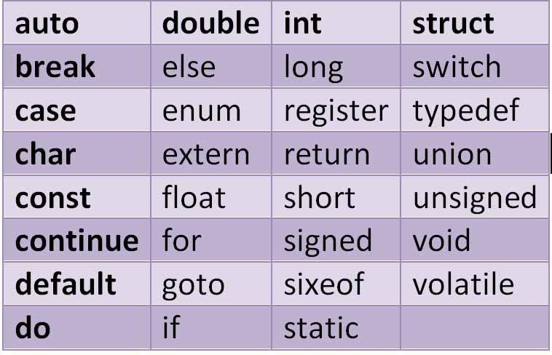
‘C’ Keywords
Keywords are the words whose meaning has already been
explained to the C compiler.
The following names are reserved by the C language. Their meaning is already defined, and they cannot be re-defined.

Slide 34

Pre-processor Directive
Pre-processor directive is #define.
#define MAX 40
#define is generally used
to define constant values
It is generally written
in upper case like MAX
It never terminates with
semicolon

Slide 35
Main Function
Syntax:
void main( )
{
---- Declarative Or Executable Statements
----
}
void main() :
Used to start of actual C program. It includes two parts as declarative Statements and executable Statements.

Slide 36

Basic Structure Of ‘C’ Program
Document Section //wap to add the 2 numbers
Links Section (File) Definition Section
Global variable declaration Section
void main()
{
Variable declaration section
Function declaration section executable statements;
}
Function definition 1
Function definition 2
---------------------
--------------------- (User Defined Functions)
---------------------
Function definition n

Slide 37


My First ‘C’ Program
#include <stdio.h>
#include<conio.h>
void main()
{
printf("\n\tHello\t\t\tWorld! ");
getch();
}
Output:-
Hello World!

Slide 38

printf
Printf : It is a function used for displaying a value or a data on the screen.
printf (“format string”, variable1, variable2 …) ;
Syntax :
Format String | Meaning | Example | Result
%d | Prints a Decimal Integer | int num=5; printf(“%d",num); | 5
%c | Prints a single character | char a=’r’; printf(“%c”,a); | r
%f | Prints a float value | float num=14.44; printf(“%f”,num); | 14.44
%s | Prints a String | char str[ 10]="icebreakers”; printf(“%s”,str); | icebreaker

Slide 39
Scanf
scanf : It is a function used for accepting a value or a data from keyboard.
scanf (“format string”, &variable1, &variable2 …) ;
Syntax :
Format String | Meaning | Example | Result
%d | Reads Integer | scanf(“%d",&num); | %d accepts the number from user and it will get stored in num’ variable.
%c | Reads a single character | scanf(“%c”,&ch); | %c accepts the character from user and it will get stored in ‘ch’ variable.
%f | Reads a float value | scanf(“%f”,&num); | %f accepts the float number from user and it will get stored in num variable.
%s | Reads a String | scanf(“%s”,str); ( & is not required) | %s accepts the string from user and it will get stored in ‘str’ variable.

Slide 40


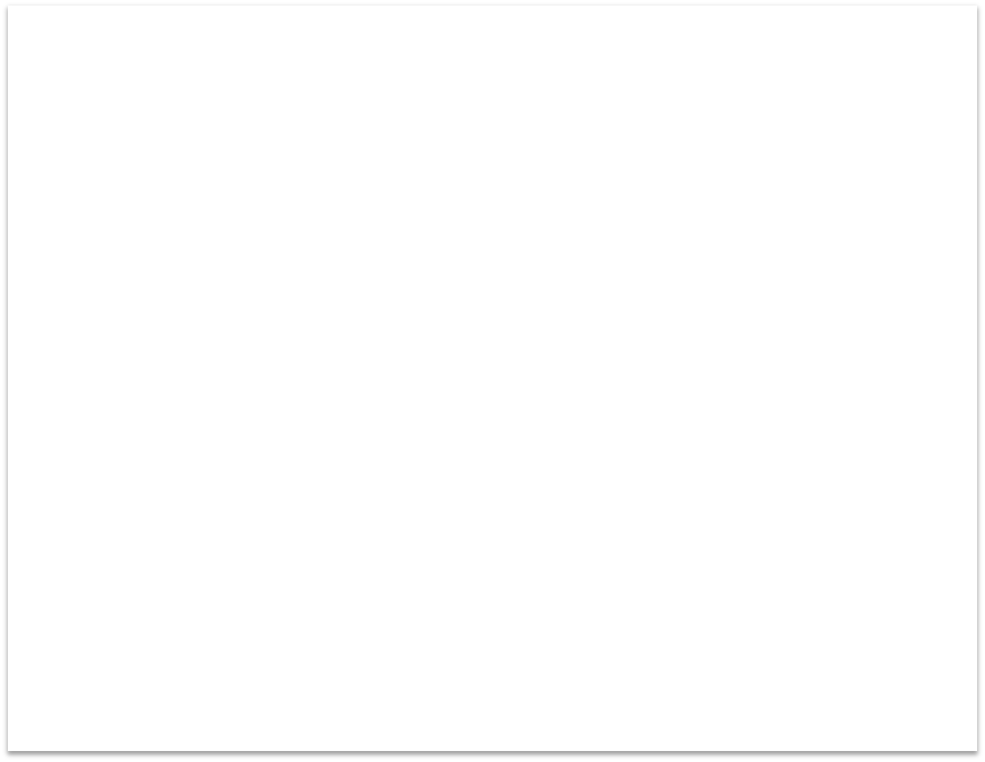




Solved Programs
Program 1 : First Program in C to wish Hello to user.
#include<stdio.h> | //including the header file
#include<conio.h> | //including the header file
int main()
{
char name[10]; | //variable declaration
clrscr(); | //Clear the output screen | Output:
printf (“Enter Name:”); scanf(“%s”,name); | //Displaying the message //Accepting the data | Enter Name:divya Hello divya
printf(“\nHello %s”,name);
getch();
return 0;
}
//function for quick output screen

Slide 41
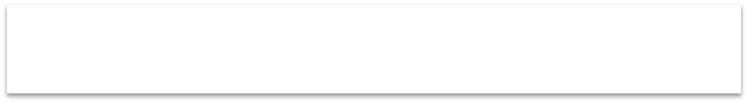




Solved Programs
Program 2 : c program to print integer
#include<stdio.h> //including the header file
#include<conio.h> //including the header file
int main()
{
int a; //variable declaration | Output:
clrscr(); //Clear the output screen | Enter any value:45
printf("Enter any value:\n"); //Displaying the message scanf(“%d”,&a); //Accepting the data | value the you | have
printf("value that you have entered is %d\n", a); | entered is 45
getch();
screen return 0;
}
//function for quick output

Slide 42
Operator Precedence
Precedence means the priority.
Each operator has some priority.
If we use multiple operators in a single expression then operator precedence helps to solve the expression.
So in the expression ,operator which has highest priority will be evaulated first.

Slide 43
Operator Precedence
Ex1:-
X= 7 + 3 * 2
So X=13

Slide 44
Operator Precedence
Ex2:- (x= =25 + 10 && y<10)
The highest priority is given to ( ).
The next priority is given to + as compare to && ,==,<
So that x = = 35 && y < 10
Now suppose x=10 and y =7.
So now < operator has higher priority than = =.
10= = 35 && 7 < 10
False && True will become false

Slide 45
Associativity
When multiple operators in an expression has same priority then the sequence of operations to be performed is decided by their associativity.
Associativity may be either left to right or right to left.
Ex:- x = 7 + 3 – 2
Here + and – operator has same priority.
And its associativity is from left to right so addition will be performed first and then subtraction.
So x = 8

Slide 46
Structure of C Program
1.Document section:-Information about the program
2.Preprocessor commands:- Required library files
3.Function section:- main ( ) function
4.Declaration section:- declaration of variables
5.Statements and expressions
6.Comments

Slide 47
// program written by Anushka
#include <stdio.h>
void main( )
{
printf("Hello, World! \n"); /* print a message */
getch();
}
}
#include <stdio.h>
int main()
{
/* my first program in C */
printf("Hello, World! \n"); return 0;
}

Slide 48
Rules in C Programming
1.Execution of every c program starts with the main( ) function
2.Each C program contains exactly one main ( ) function
3.Every C statement in C program ends with semicolon ( ;)

Slide 49
Rules in C Programming
4.Most of the statements in C program are in lowercase
5.Each opening brace should have its closing brace
6.C can contain the comments anywhere in the program
7.The execution of program starts with the opening { of main function and ends with } main( ) function.

Slide 50
Stdio.h :- It is a standard Input Output header file.
This file is used to perform standard input output operations like printf and scanf functions..
Conio.h :- It is a Console Input Output header file.It is used to perform console(monitor) related operations like getch( ) function.
Math.h:- This file is used to perform or supports all the mathematical related functions in C langauge.

Slide 51
Input Statements /Functions
Input functions are used to accept the input by user for a program.
User enters the data through the keyboard.
Standard input functions:-
1.scanf( ) :- used for accepting a value or a data from keyboard
2.getchar( ) :- is used to get/read a one character from keyboard
3.getch ( ) :- Accepts a character
4.gets ( ) :- It accepts and stores the sequence of characters

Slide 52
Output Statements /Functions
Output functions are used to print the values of variables on the monitor.
Standard Output functions:-
1.printf ( ) :- It is a function used for displaying a value or a data on the screen
2.Putchar ( ) :- used to write a character on standard output/screen.
3.Putch ( ) :- :- it takes an ASCII int value as argument and then prints corresponding character
4.Puts ( ) :- takes an character array as argument and print the value stored in the character on the screen

Slide 53
WAP to display a statement “Hello Friend”
Algorithm Name: Display a statement “Hello Friend”
Input:
Output: Hello Friend
Step 1:- start
Step 2: display the sentence “Hello Friend”using printf( ) function
Step 3: stop

Slide 54
Program
// Write a program to display “Hello Friend
#include<stdio.h>
#include<conio.h>
void main( )
{
clrscr( );
printf(“\n Hello Friend”);
getch();
}
Output:- Hello Friend

Slide 55
Write a program to print value of variable a having int data type
Algorithm Name: Print value of variable a
Input:- a
Output: value of a
Step1: start
Step2:- declare variable a = 20
Step 3: display value of a
Step 4:stop

Slide 56
program
#include<stdio.h>
#include<conio.h>
void main( )
{
int a =20;
clrscr( );
printf(“\n value of a is %d”,a);
getch();
}
Output:- value of a is 20

Slide 57
Write a program to accept value of variable a having int data type and display it
Algorithm Name: Accept and Print value of variable a
Input:- a
Output: value of a
Step1 : start
Step2:- declare variable a
Step3:- accept / read value of a
Step 4: display value of a
Step 5:stop

Slide 58
program
#include<stdio.h>
#include<conio.h>
void main( )
{
int a ;
clrscr( );
printf(“\n enter value of a:“);
scanf(“%d”,&a);
printf(“\n value of a is %d”,a);
getch();
}
Output:- enter value of a: 10
value of a is 10

Slide 59
Write a program to print value of 2 variables
Algorithm name:- print value of 2 variables
Input : a ,b
Output: value of a ,b
Step1: start
Step2 : declare variables a, b
Step3:display value of a and b
Step 4: stop

Slide 60
program
#include<stdio.h>
#include<conio.h>
void main( )
{
int a =20;
int b=30;
clrscr( );
printf(“\n value of a is %d”,a);
printf(“\n value of b is %d”,b);
getch();
}
Output:- value of a is 20
value of b is 30

Slide 61
Write a program to accept and display the value of a and b having int datatype
#include<stdio.h>
#include<conio.h>
void main( )
{
int a ,b;
clrscr( );
printf(“\n enter value of a:“);
scanf(“%d”,&a);
printf(“\n enter value of b:“);
scanf(“%d”,&b);
printf(“\n value of a is %d”,a);
printf(“\n value of a is %d”,b);
getch();
}

Slide 62
Output:- enter value of a: 10
enter value of b: 20
value of a is 10
value of b is 20

Slide 63
WAP to convert temperature in fahrenheit degrees to centigrade degrees
Algorithm:
Algorithm name:- to convert temperature in fahrenheit degrees to centigrade degrees
Input:- Fahrenheit
Output: Celcius
Step1:start
Step2:- Declare variables f and c
Step3:- Read value of f
Step4:- calculate temperature in celcius c=(f-32)/1.8
Step5:- Display celcius temperature
Step 6:-stop

Slide 64
#include<stdio.h>
#include<conio.h>
void main( )
{
float f,c ;
clrscr( );
printf(“\n enter temperature in fahrenheit: “);
scanf(“%f”,&f);
c=(f-32)/1.8;
printf(“\n The converted temperature in celcius is %f ”,c);
getch();
}

Slide 65
WAP to calculate the area and perimeter of the rectangle
Algorithm:
Algorithm name:- to calculate the area and perimeter of the rectangle
Input:- length and breadth
Output: area and perimeter
Step1:start
Step2:- Declare variables length,breadth ,area ,perimeter
Step3:- Read value of length and breadth
Step4:- calculate area area=length*breadth
Step5:- Display area of rectangle
Step 6:-calculate perimeter, perimeter= (2*length) + (2*breadth)
Step7:display perimeter of rectangle
Step8:stop

Slide 66
#include<stdio.h>
#include<conio.h>
void main( )
{
int length,breadth,area ,perimeter
clrscr( );
printf(“\n enter length and breadth: “);
scanf(“%d %d ”,&length, &breadth);
area= length * breadth;
printf(“\n The area of rectangle is %d ”,area);
perimeter=(2*length) + (2*breadth);
printf(“\n The perimeter of rectangle is %d ”,perimeter);
getch();
}

Slide 67
WAP to calculate the area and circumference of the circle
Algorithm:
Algorithm name:- to calculate the area and circumference of the circle
Input:- radius and pi
Output: area and circumference
Step1:start
Step2:- Declare variables pi,radius ,area ,circumference
Step3:- Read value of radius
Step4:- calculate area i.e. area=pi*radius*radius
Step5:- Display area of circle
Step 6:-calculate circumference i.i circumference= 2*pi *radius
Step7:display circumference of circle
Step8:stop

Slide 68
#include<stdio.h>
#include<conio.h>
const float pi=3.14;
void main( )
{
float radius,area ,circumference;
clrscr( );
printf(“\n enter radius: “);
scanf(“%f “,&radius);
area= pi*radius*radius;
printf(“\n The area of circle is %f”,area);
circumference=2*pi*radius;
printf(“\n The circumference is %f ”,circumference);
getch();
}

Slide 69
WAP to accept a number and display its square
Algorithm:
Algorithm name:- To accept a number and display its square
Input:- number
Output: square
Step1:start
Step2:- Declare variable number,square
Step3:- Read value of number
Step4:- calculate square i.e. square=number * number
Step5:- Display square
Step6:stop

Slide 70
#include<stdio.h>
#include<conio.h>
void main( )
{
int number,square;
clrscr( );
printf(“\n enter the number: “);
scanf(“%d “,&number);
square = number*number;
printf(“\n The square of number is : %d”,square);
getch();
}

Slide 71
Increment Operator
Increment operator is the unary operator ,it means that they take one operand to perform operation on it.
Increment operator adds one to the variable…or the value of the variable is incremented by one.
Example: i=1;
i++;
then i becomes 2

Slide 72
Preincrement operator
++a :- It is a preincrement operator.
Preincrement operator adds one to the variable and then perfrom the assignment operation.
Example:-
int a=5;
int b=++a;
Output:- a=6
b=6

Slide 73
Post increment operator
a++ :- It is a post increment operator.
Post increment operator do the assignment operation first and then add one to the variable
Example:-
int a=5;
int b=a++;
Output:- a=6
b=5

Slide 74
Decrement Operator
Decrement operator is the unary operator ,it means that they take one operand to perform operation on it.
Decrement operator substracts one to the variable…or the value of the variable is decremented by one.
Example: i=2;
i--;
then i becomes 1

Slide 75
Predecrement operator
--a :- It is a preidecrement operator.
preidecrement operator substract the one from the variable and then perfrom the assignment operation.
Example:-
int a=5;
int b=--a;
Output:- a=4
b=4

Slide 76
Post Decrement operator
a-- :- It is a post decrement operator.
Post decrement operator do the assignment operation first and then substract one from the variable
Example:-
int a=5;
int b=a++;
Output:- a=4
b=5

Slide 77
Prefix operator first add/substract 1 to the operand and then the result is assigned to the variable on the left.
A postfix operator first assigns the value to the variable on the left and then increments the operand

Slide 78
Data type Conversion
Conversion between data typs can be done In 2 ways
1.Implicit conversion
2.Explicit conversion

Slide 79
Implicit Conversion:- is done internally by compiler.
int x=123;
double y=x;
In above statement ,the conversion of data from int to double is done implicitly

Slide 80
Explicit Conversion:- is done by the users.
double y=123;
int x==int(y);
In above statement ,we have to specify the type operator (int) when converting from double to int else the compiler will give an error.

